Slide 1
Magnetic Resonance Imaging
Santiago Araya Ramos
Roshan Yogendra

Slide 2
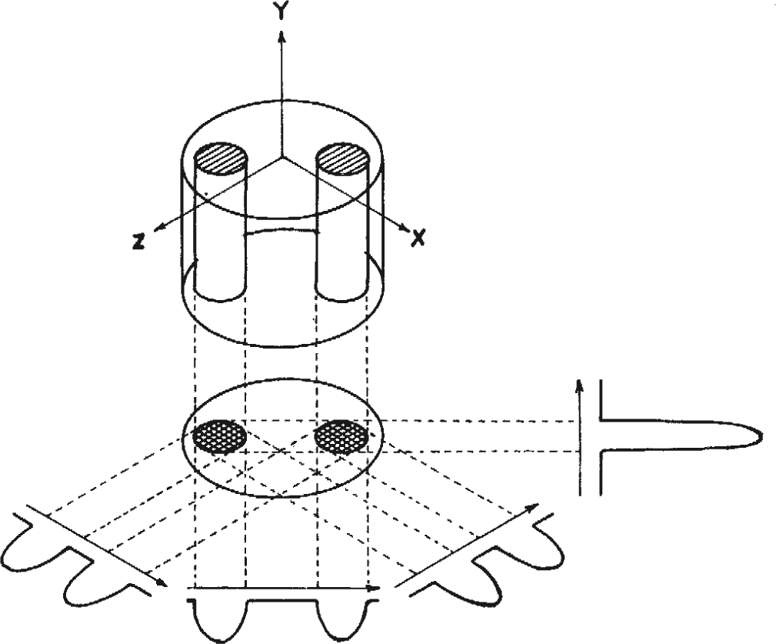
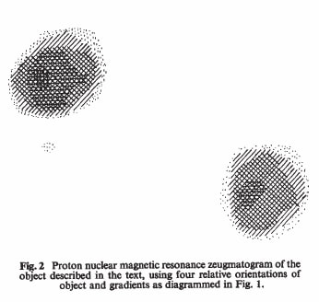
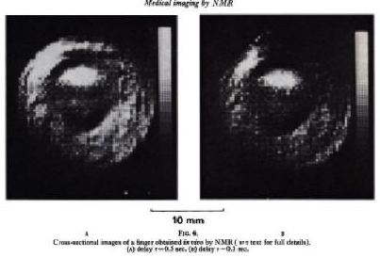
History of MRI
Base technology: NMR molecular analysis (Felix Bloch and Edward Purcell Nobel in 1952)
First proof of concept for imaging: Using magnetic gradients to localize signal components in space (Paul C. Lauterbur.
Improve imaging speed and gradient based slice selection (Sir Peter Mansfield)
Source: https://benbeck.co.uk/firsts/2_The_Human_Subject/scanningh.htm
Notes:
Felix bloch and edward purcell pionered NMR technology for protons in 1946.
Lauterbur inspired by Raymond damadian (cancer tissue and normal tissue is significantly different in NMR), results reproduced by Leon Saryan (they killed the rats to image them). He used back-projection imaging to help with localization (basically combining many 2d projections to create localized 2d images
Sir Peter mansfield continued to Develop MRI technology, advancing the mathematical analysis used beyond backpropagation. He added slice selection to enable to excite only specific slices of the body, and enabling the practicality of MRI in real clinical settings by decreasing scan time from minutes to hours down to seconds.

Slide 3
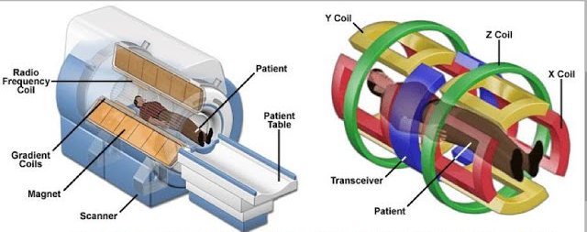
Basic principles of MRI
Source: https://www.youtube.com/watch?v=FT6NwrEFv0o
The physics behind it:
Each proton acts like a small magnet (due to spin)
A powerful uniform magnetic field aligns protons parallel or antiparallel to it
Radio waves temporarily knock protons off alignement and synchronise them
As protons realign, a detectable electromagnetic signal is emitted.
How we image:
Emitted radio wave frequency∝Magnetic field magnitude and intrinsic constants
Gradient magnets vary frequency of emitted radio wave based on location.
Analyse the combined signal of all spins with the inverse Fourier transform.
We now can create images with localised proton signals
Notes:
Th

Slide 4
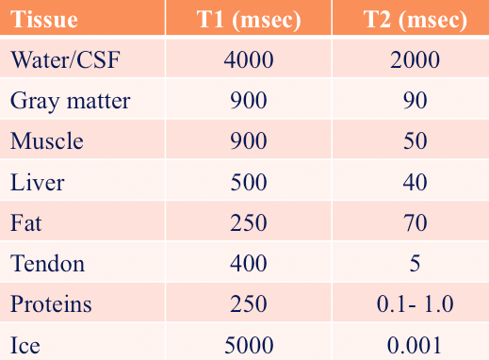
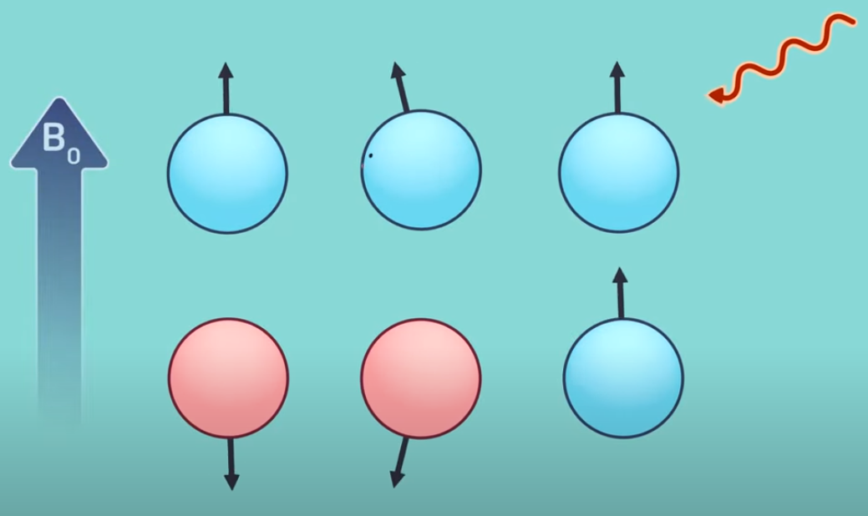
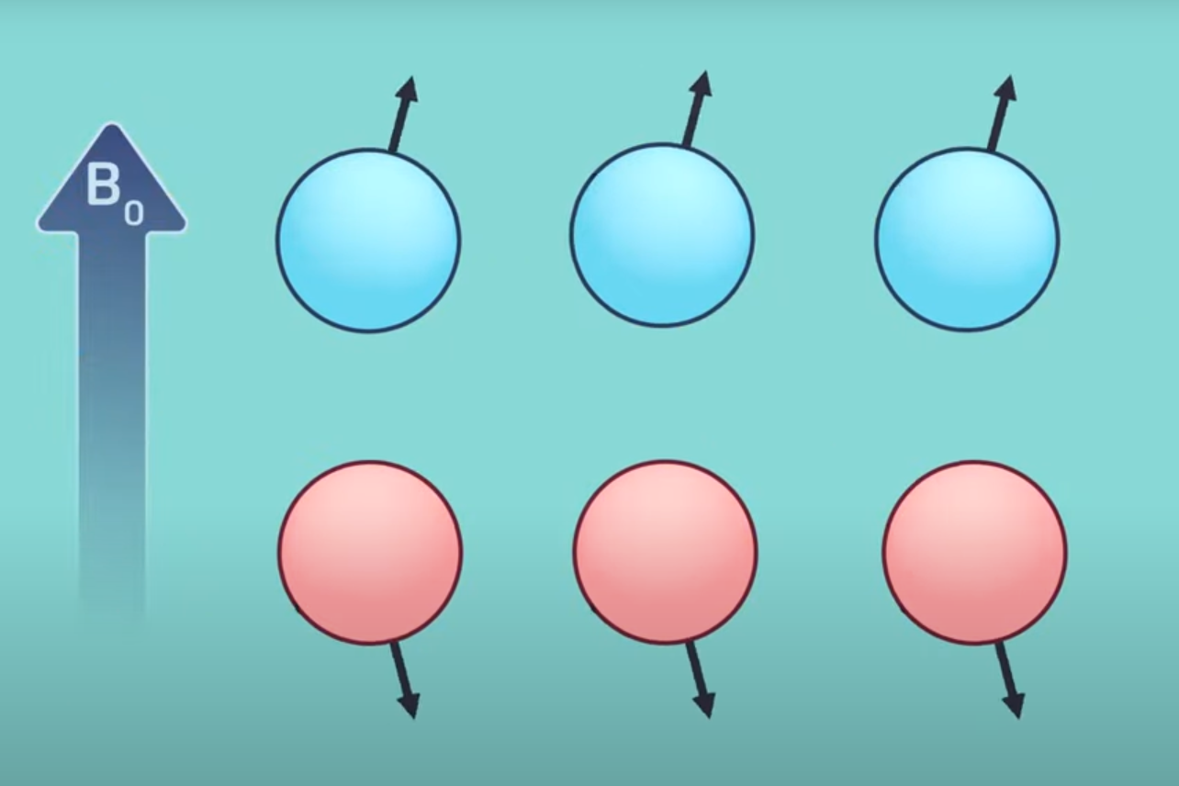
What is measured?
The Total Magnetization vector is the sum of magnetic
field from all protons' spin and state transitions.
Two main measured tissue properties:
  T1 time: Time it takes for 67% of the total longitudinal magnetization to recover (Time for spins to recover to equilibrium conditions)
  T2 time: Time it takes for 67% of the total transverse magnetization to decay (Time spins in precession to dephase after excitation)
Source: https://mri-q.com/why-is-t1--t2.html
Source: John Hopkins Medecine https://youtu.be/jLnuPKhKXVM?si=DyenJndOwr6idqbE

Slide 5
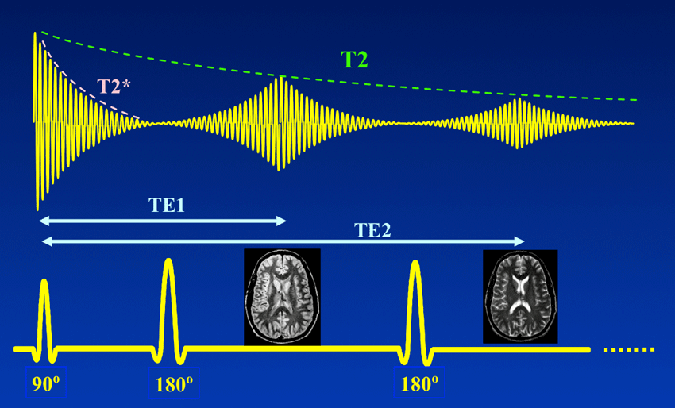
Complications
T2 isn't exactly what can be measured, T2* is the actual dephasing time:
  Magnetic field isn't really uniform, small variation make big changes
  Interference from chemical shift, other molecules, paramagnetic substances.
  Solutions: Increase magnetic field uniformity, and Spin-echo
Source: https://mriquestions.com/se-vs-multi-se-vs-fse.html

Slide 6
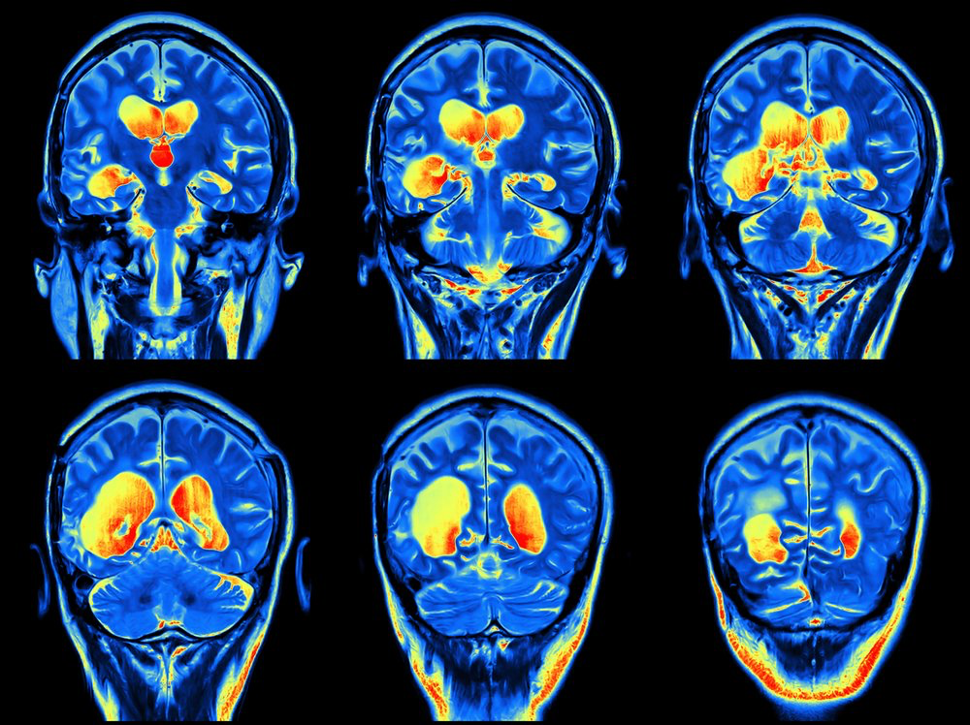
MRI with contrast
Agent to get clearer images
Gadolinium
  Injected to make tissues appear brighter
  Highlights tumors, inflammation, blood vessels
  Generally safe
Hyperpolarized Noble Gases
  Inhaled helium-3
  Creates strong MRI signal in lungs
  Shows airflow and gas exchange in lung diseases
Potential risk of complications
https://multiplesclerosisnewstoday.com/2019/03/12/need-to-know-do-i-need-contrast-dye-gadolinium-mri/
Notes:
Sometimes MRI uses contrast agents to get even clearer images.
First, gadolinium contrast is injected into the bloodstream. Gadolinium is a metal that makes tissues with abnormal activity, like tumors or inflammation, appear brighter on the scan. It's generally very safe, but doctors avoid it in patients with severe kidney disease.
Another method is using hyperpolarized noble gases:
the spins of the gas atoms’ nuclei have been made artifically to align more with the magnetic field.
In normal conditions, only a tiny fraction of atoms have their spins aligned.
After hyperpolarization, a much larger percentage of atoms are aligned in the same direction.
This greatly increases the strength of the magnetic signal they give off in an MRI
like helium-3, which are inhaled. This lets doctors see how air moves and how well gas is absorbed making it very useful for diagnosing lung diseases like asthma or emphysema.
potential risks so not recommended to everyone

Slide 7
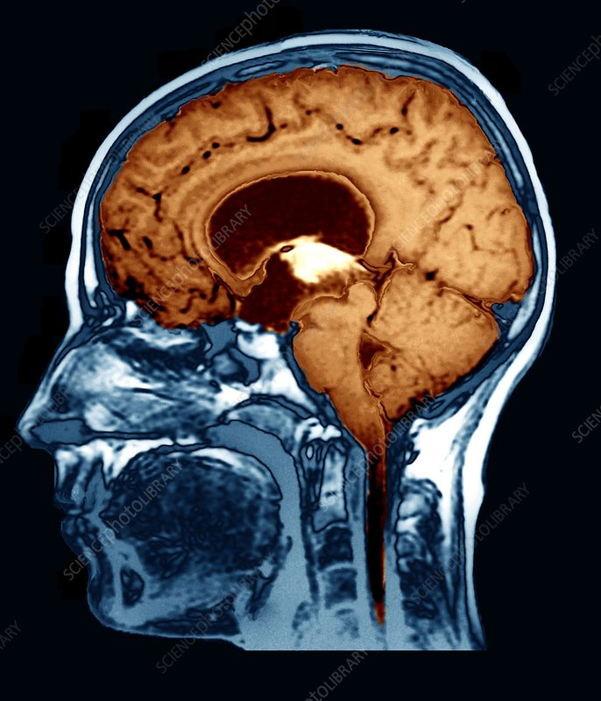
Advantages of MRI
Strong signals due to water
No ionizing radiation
Detailed 3d images
Replaces invasive procedure
https://www.sciencephoto.com/media/257506/view/water-on-the-brain-mri-scan
Notes:
MRI is powerful because it detects the protons found in hydrogen atoms.
Since two-thirds of the human body is made of water, and water molecules contain hydrogen atoms, MRI can create strong signals based on the large amount of hydrogen present.
MRI does not use ionizing radiation (radiation that have enough energy to ionize atoms or molecules by detaching electrons from them, can damage or break molecules like DNA), unlike X-rays or CT scans, making it a safer imaging method for patients.
It produces highly detailed three-dimensional images of organs and tissues by detecting differences in hydrogen density and environment.
MRI has replaced many invasive diagnostic procedures, reducing the risks, discomfort, and recovery time for patients.
Before MRI, examining the pancreatic and bile ducts (important part of the digestive system) required inserting an endoscope (medical device with light and image sensor) and injecting dye, which could cause serious complications. MRI now replaces this with a safer, non-invasive scan.

Slide 8
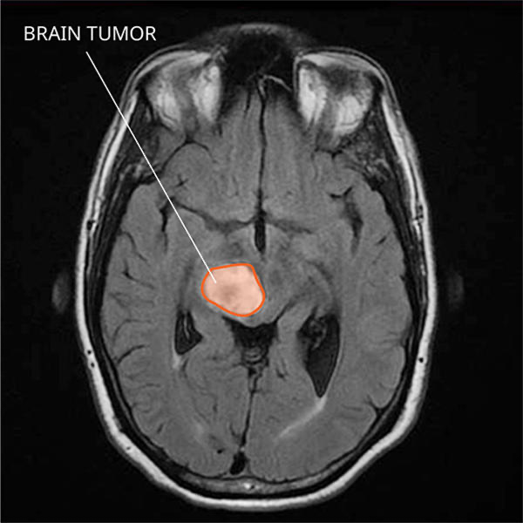
Importance in Medicine
Cancer Diagnosis
Defines tumor boundaries
Defines tumor stage
Preoperative tool
Guides precise surgery
Use them to place electrodes
Brain and Spine diagnosis
Detects small water content changes
Important for diseases like multiple sclerosis
https://www.cancer.gov/rare-brain-spine-tumor/tumors/diffuse-midline-gliomas
Notes:
MRI is also a powerful preoperative tool. It gives detailed 3D images that surgeons use to guide operations, including placing electrodes deep inside the brain to treat conditions like Parkinson’s disease.
Many diseases the pathological process (changes in the structure and function of cells or tissues that lead to the disruption of the production of biologically active substances) results in changes of water content, which is reflected in MRI.
In multiple sclerosis, where the protective myelin around nerves is damaged, MRI can show exactly where inflammation is happening.
In cancer, MRI is used to define tumor boundaries (tumor cells tend to hold more water content) and to see how deeply a tumor has invaded nearby tissues. This helps plan precise surgery and radiation therapy and determines the stage of the cancer.

Slide 9
Summary
MRI uses magnetic fields and radio waves to create detailed images
Hydrogen atoms in water are key for detecting tissues
MRI is non-invasive and avoids ionizing radiation
Essential for brain, spine, cancer diagnosis, and surgical planning
Notes:
In summary, MRI uses magnetic fields and radio waves to create highly detailed images inside the body.
It works by detecting hydrogen atoms, which are abundant because two-thirds of the body is water.
MRI is non-invasive, safe, and avoids the risks of ionizing radiation.
It's crucial for diagnosing conditions in the brain, spine, and cancers, and it also plays a major role in surgical planning.

Slide 10
Bibliography
https://www.myssmi.com/blog/with-contrast-vs-without-what-s-the-difference#:~:text=Scans%20with%20contrast%20are%20used,brain%20tumors%2C%20and%20brain%20aneurysms.
https://www.nobelprize.org/prizes/medicine/2003/press-release/
https://www.cancer.gov/rare-brain-spine-tumor/tumors/diffuse-midline-gliomas
https://www.sciencephoto.com/media/257506/view/water-on-the-brain-mri-scan
https://www.ncbi.nlm.nih.gov/books/NBK564320/
https://mri-q.com/who-invented-mri.html
https://www.youtube.com/watch?v=vapJRr6gAds
https://www.khanacademy.org/test-prep/mcat/physical-processes/proton-nuclear-magnetic-resonance/a/magnetic-resonance-imaging-mri

